Slide 1
Fruitripe Avocado Shelf Life Study
Windham Packaging, LLC
Fresh Check Postharvest Consulting, LLC
Fruitripe Cold Storage & Ripening Services

Slide 2
Procedure
CA avocados were packaged and weighed in Fruitripe facility (72°F)
Control (netted bags) tied with Kwik-Lock closure
hydro-sureTM MAP bag, heat sealed
Laminate Zipper MAP bag, heat sealed
Avocados shipped overnight to Windham Packaging Lab
Avocados were stored in 55°F for 5 days and then moved to room temperature (68-70°F, RT)
Avocados were tested on days 9, 12, 15, and 18
Two bags per treatment were opened on each test day.
Avocados from the first bag were used for photographs and testing
Avocados from the second bag were left to ripen in air for 2 days or until fully ripe

Slide 3
Procedure: Quality Testing
Weight was checked on days 0, 5, 9, 12, 15, and 19 using a digital scale
Expressed as weight loss (%)
Visual observations such as dehydration, bruising, dents, firmness to touch, color changes, and visible mold/bacterial growth were noted
Headspace readings inside packages were checked using a gas analyzer
Firmness (lbs.) was measured by removing the peel on two sides of the fruit and using a penetrometer with an 8mm tip

Slide 4
Weight Loss
Weight loss increased in all treatments during storage

Slide 5
Weight Loss
Weight loss increased in all treatments during storage
Avocados in control bags had the highest % weight loss

Slide 6
Weight Loss
Weight loss increased in all treatments during storage
Avocados in control bags had the highest % weight loss
Avocados in laminate bags had the lowest % weight loss
MAP technology delayed ripening
Moisture was maintained

Slide 7
Weight Loss
Weight loss increased in all treatments during storage
Avocados in control bags had the highest % weight loss
Avocados in laminate bags had the lowest % weight loss
MAP technology delayed ripening
Moisture was maintained
Avocados in hydro-sureTM bags had significantly less % weight loss than the control, but more than laminate
MAP technology delayed ripening
Excess water was removed

Slide 8
Weight Loss
Once avocados were removed from bags, weight loss increased

Slide 9
Weight Loss
Once avocados were removed from bags, weight loss increased

Slide 10
Firmness
Decreased in all avocados during storage
Optimum firmness for eating: 1.51 to 0.99 lb

Slide 11
Firmness
Decreased in all avocados during storage
Optimum firmness for eating: 1.51 to 0.99 lb
By day 9, control avocados were already at 0.75 lb and fully ripe
By day 15, all control avocados were so soft they could not get a firmness reading

Slide 12
Firmness
Decreased in all avocados during storage
Optimum firmness for eating: 1.51 to 0.99 lb
By day 9, control avocados were already at 0.75 lb and fully ripe
By day 15, all control avocados were so soft they could not get a firmness reading
Both Laminate and hydro-sureTM bags reduced loss of firmness during storage

Slide 13
Headspace
Reduced O₂ and increased CO₂ prolongs shelf life in avocados

Slide 14
Headspace
Reduced O₂ and increased CO₂ prolongs shelf life in avocados
Control (netted) bags maintained an ambient atmosphere (21% O₂ and 0.3% CO₂, not shown)

Slide 15
Headspace
Reduced O₂ and increased CO₂ prolongs shelf life in avocados
Control (netted) bags maintained an ambient atmosphere (21% O₂ and 0.3% CO₂, not shown)
Laminate and hydro-sureTM bags reduced O₂ and increased CO₂

Slide 16
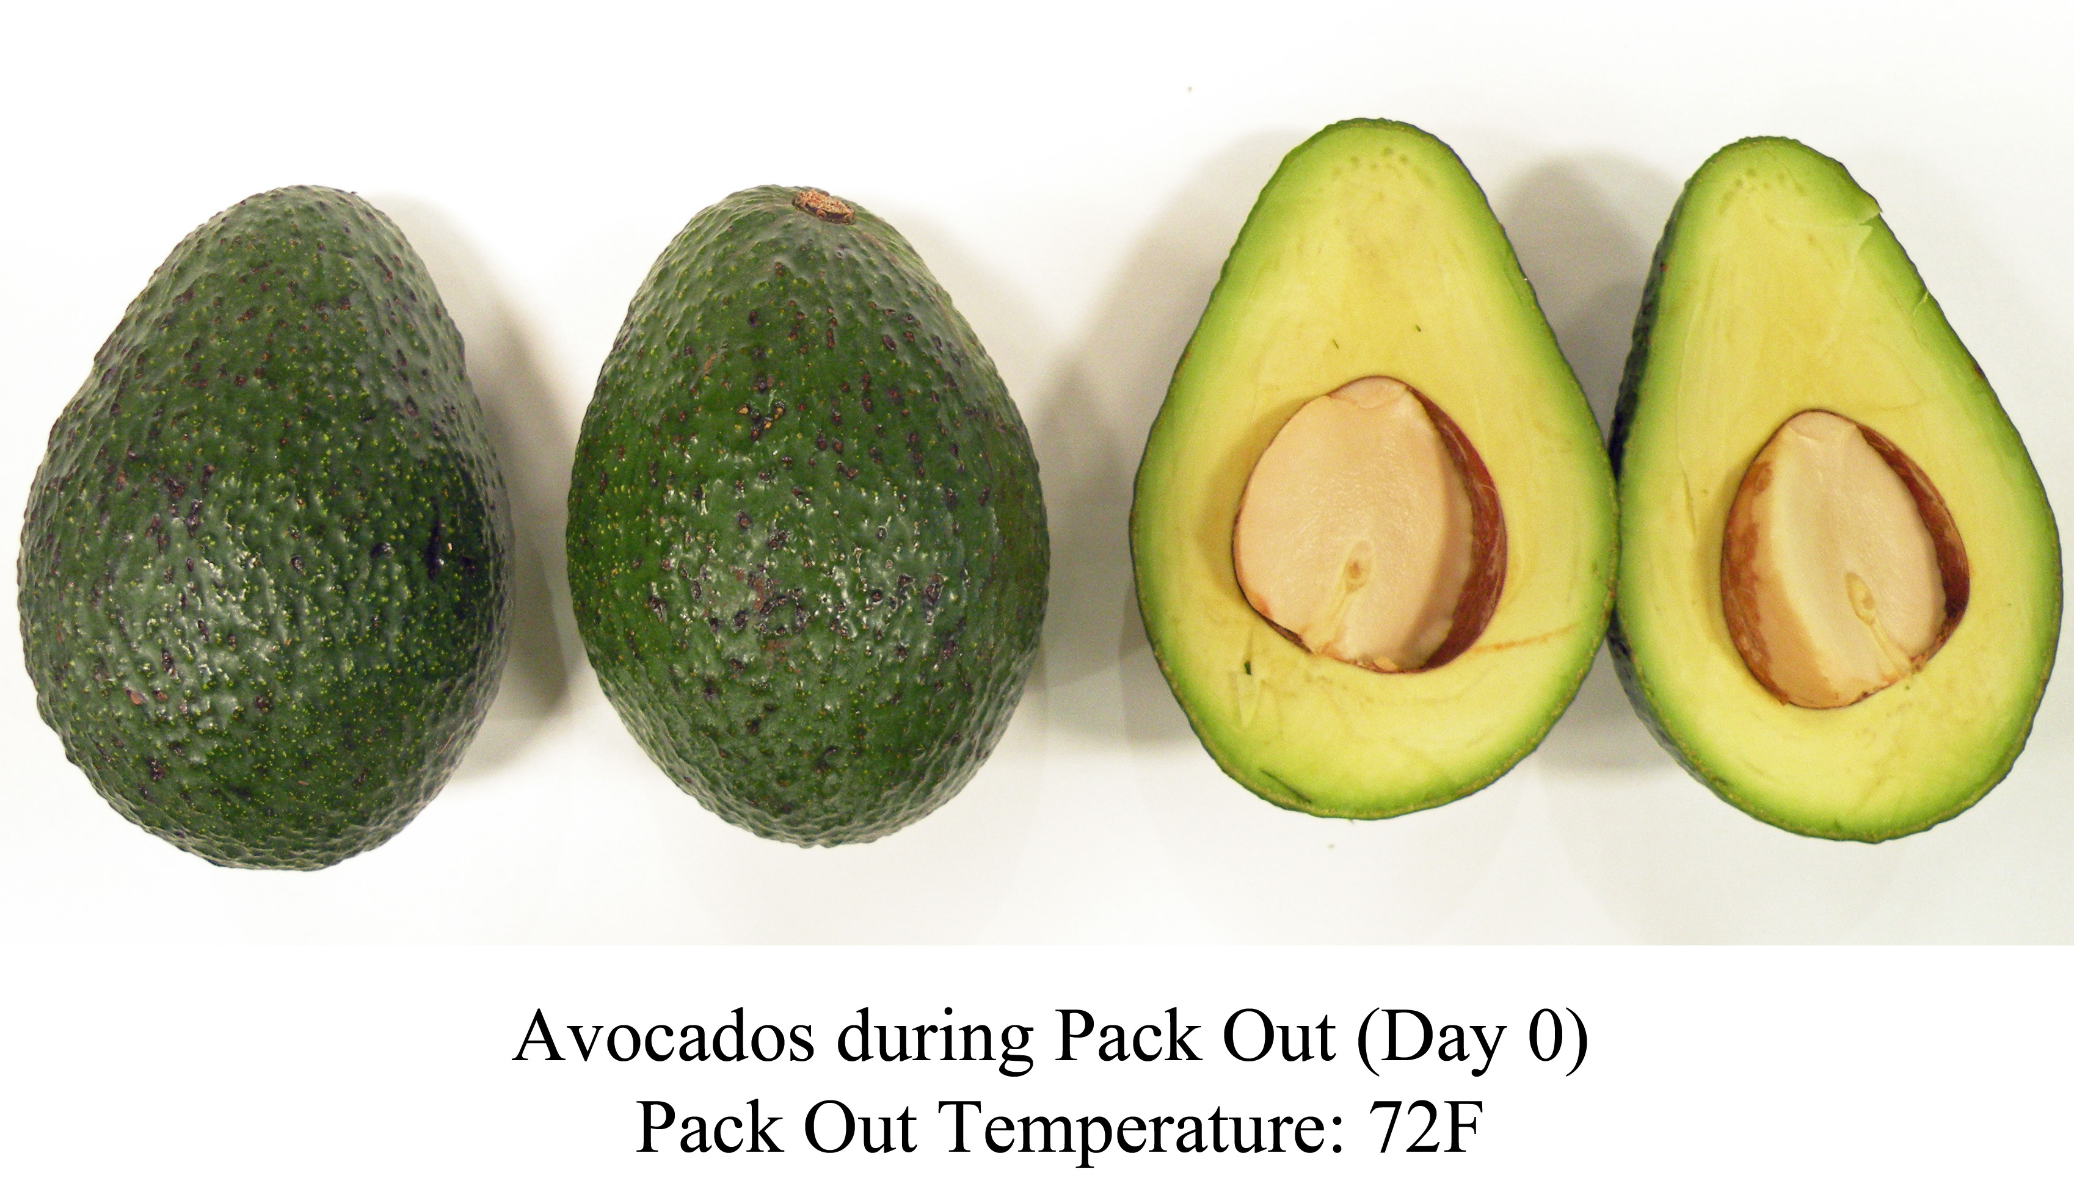
Visual Quality and Taste
Day 0
All avocados had dark green peel and light green pulp, free of defects

Slide 17
Visual Quality and Taste
Day 0
All avocados had dark green peel and light green pulp, free of defects
Day 9
Control avocados were completely ripe and beginning to rot
hydro-sureTM avocados had dark green peels and pulp was unripe
Laminate avocados were unripe and condensation was forming inside the bags. 2% avocados showed early signs of white mold

Slide 18
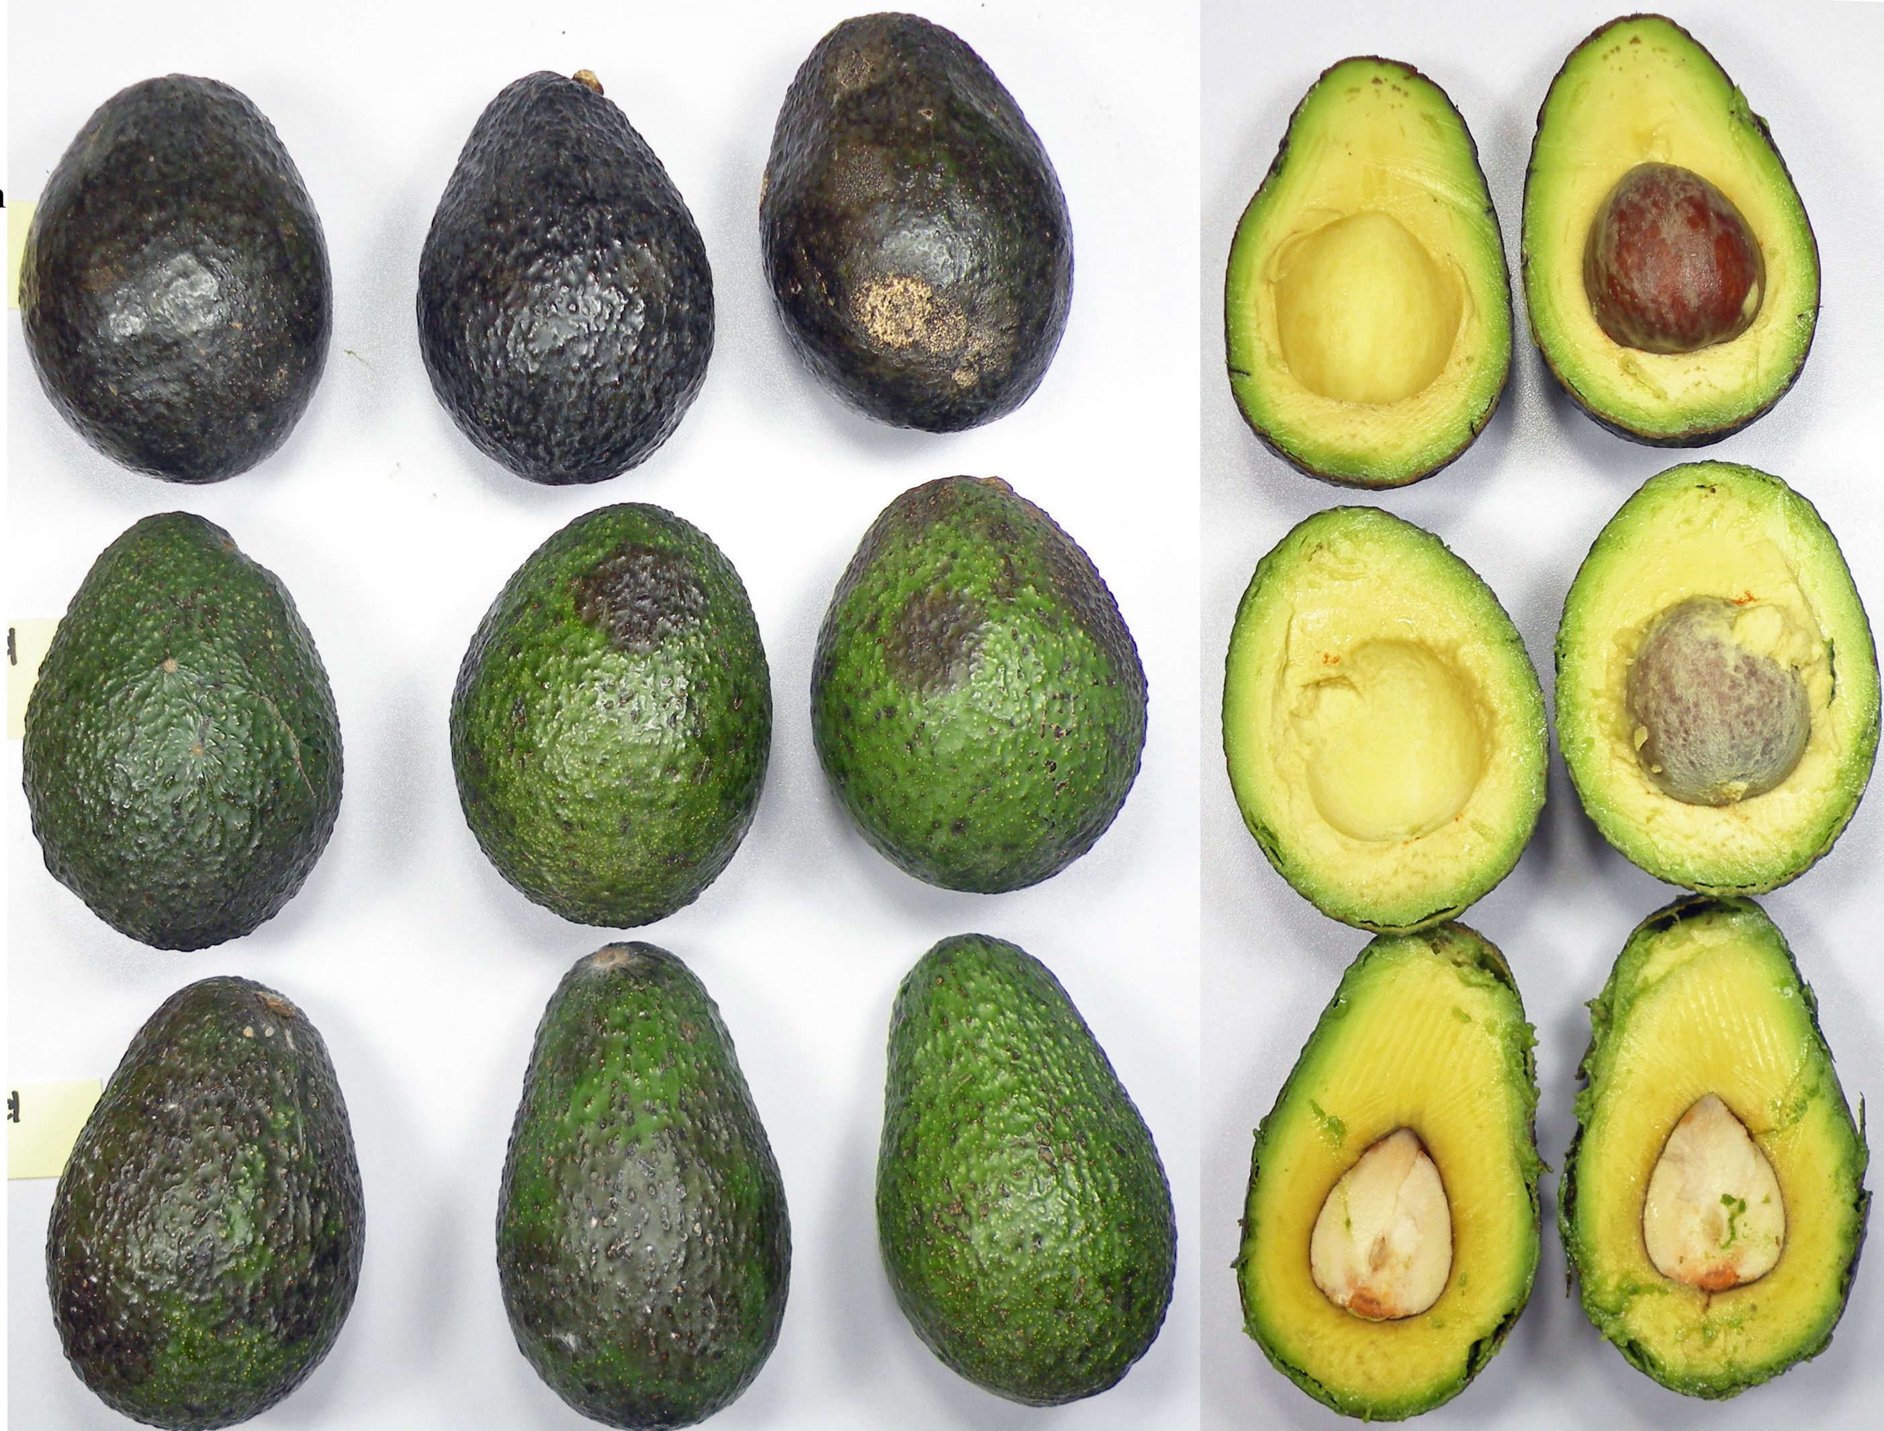
Visual Quality and Taste
Day 12
90.5% Control avocados were purple, 35% were rotting
hydro-sureTM avocados were starting to change peel color from green to purple. The pulp was soft but not creamy with “grassy” aftertaste
Laminate bags had condensation and 26% avocados had white mold
During ripening, the peel color of the control avocados changed evenly while avocados in both MAP bags appeared blotchy. Pulp quality was not affected.
Avocados stored in Control (top), hydro-sureTM (middle), and laminate(bottom) bags for 12 days: 4 days in 55°F + 8 days in RT

Slide 19
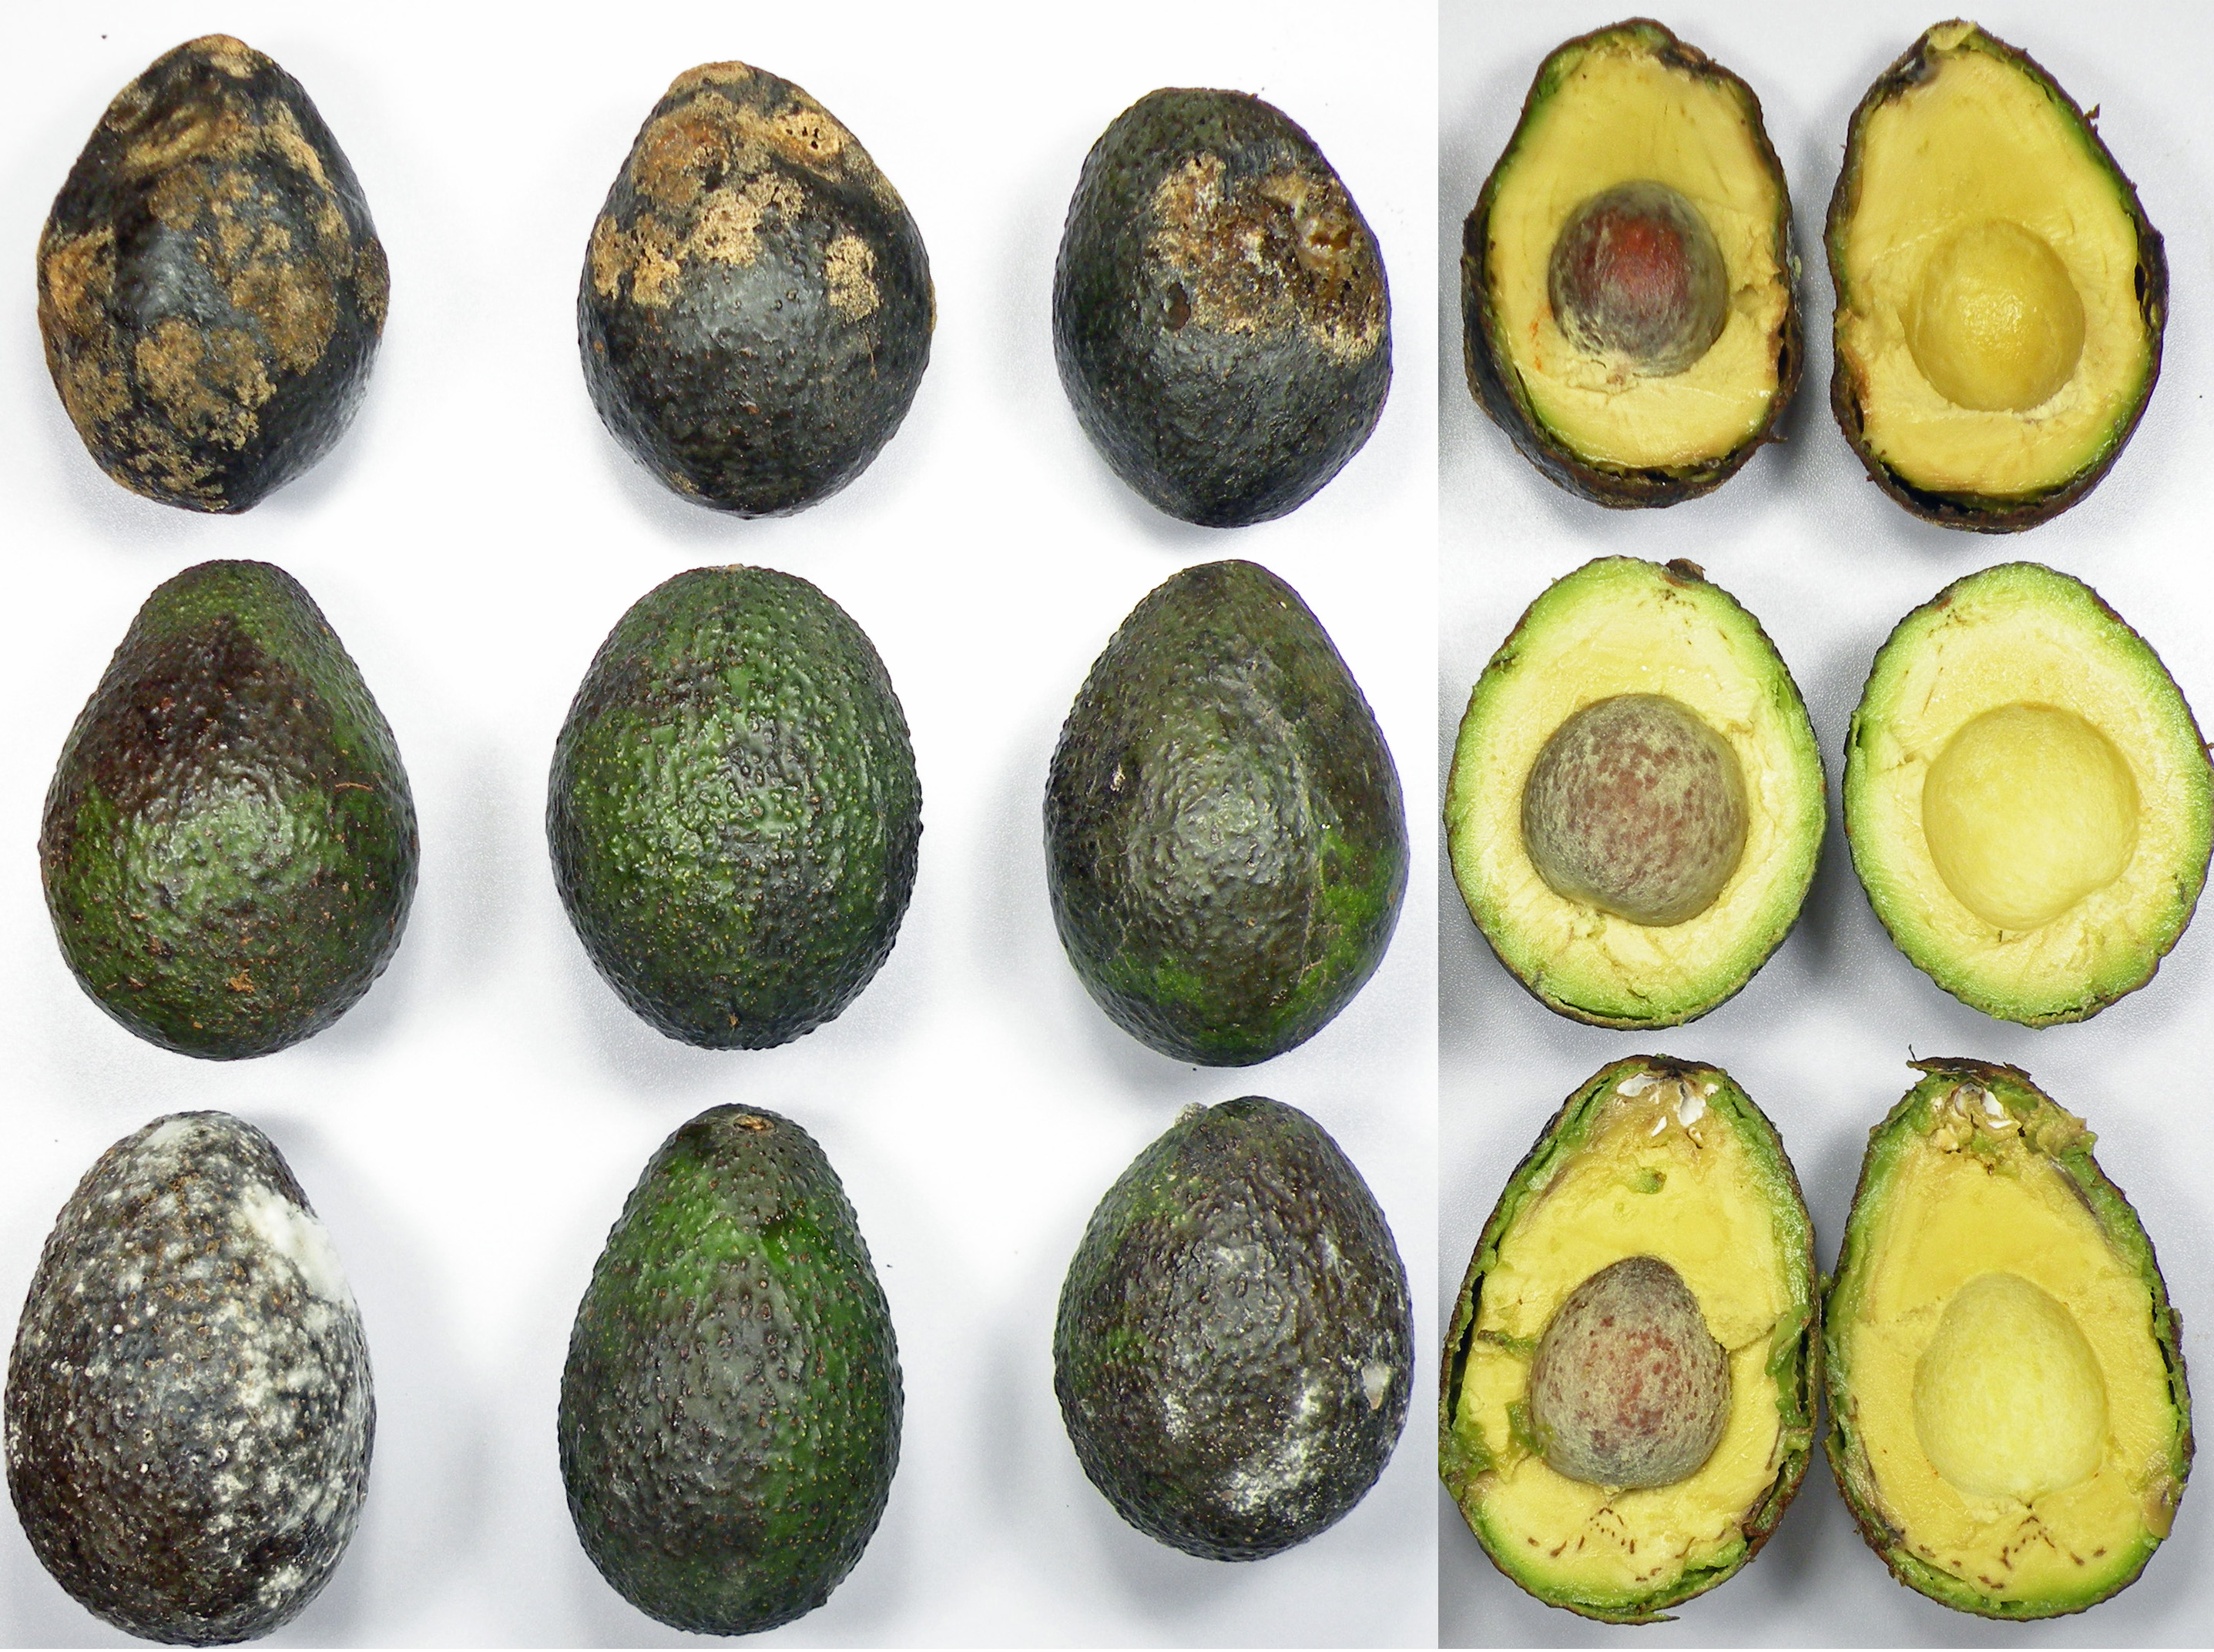
Visual Quality and Taste
Day 15
100% control avocados were rotted
hydro-sureTM avocados had good taste and soft, creamy texture. The pulp was ripe even though the peels were partially green
100% avocados in laminate bags had mild to severe white mold
Control and laminate avocados were discarded
Avocados stored in Control (top), hydro-sureTM (middle), and laminate(bottom) bags for 15 days: 4 days in 55°F + 11 days in RT

Slide 20
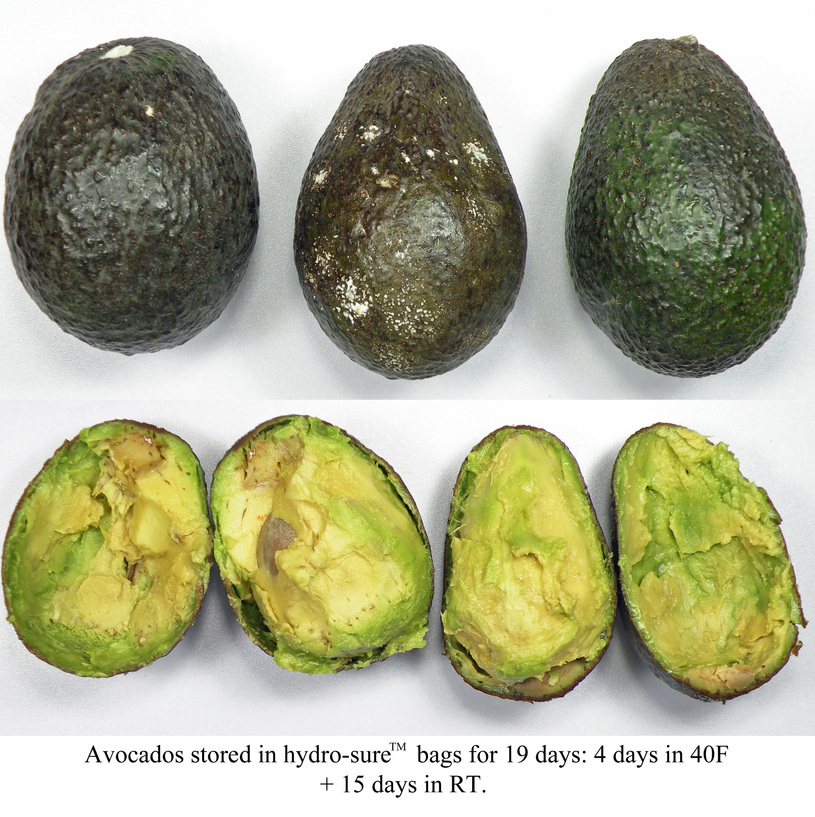
Visual Quality and Taste
Day 19
62.5% hydro-sureTM avocados had completely purple peels, 16.7% were mostly purple, with some green
21% were rotting
58% had white mold
Pulp was overripe and difficult to make a clean cut
Avocados stored in hydro-sureTM bags for 19 days: 4 days in 55°F + 15 days in RT

Slide 21
Conclusions
Avocados in control netted bags had a shelf life of 9-10 days
Laminate bags reduced loss of weight and firmness, but the excess moisture led to significant increases in white mold which was detrimental to shelf life. Laminate bags are not an option for extended shelf life packaging of avocados.
Avocados in hydro-sureTM bags had the longest shelf life of all the avocados. We estimate that when kept in hydro-sureTM bags avocados can have a shelf life of up to 17 days.
hydro-sureTM bags offer the best option for extending the shelf life and quality of avocados

Slide 22
Conclusions
The optimum O₂ flux we select for the hydro-sureTM bags will depend on the goal of the customer
If the avocados are expected to be shipped over long distances, MAP bags with lower O₂ fluxes may be right for that purpose.
If the goal is to provide close to ready-to-eat avocados at retail, then higher O₂ fluxes will be required.
We can match the O₂ requirements to your commercialization goals.

